Slide 1
All the HIGHT You Need on Cortex-M4
Hwajeong Seo¹, Zhe Liu²
¹Hansung University, ²Nanjing University of Aeronautics and Astronautics

Slide 2


Background
Data encryption is a fundamental building block for secure communication
The cryptography implementation needs to satisfy two requirements
High-speed computation → high availability of application
Secure computation → strong security against side channel attack

Slide 3
Background (Side Channel Attack)
Side Channel Attack: any attacks based on information gained from the physical implementation of cryptosystem
Passive Attack: monitoring timing information, power consumption, electromagnetic leaks or sound
Active Attack: fault injection on cryptosystem, manipulation of the instruction opcodes

Slide 4
Background (Fault Attack Model)
Computation Faults: errors in the data that is processed by a program
Random word: targeting a specific word in a program to a random value
Random byte: targeting a single byte of word in a program to a random value
Random bit: targeting a single bit of word in a program to a random value
Chosen bit pair: targeting a chosen bit pair of word in a program to a random value
Instruction Faults: changing the program flow
Instruction skip fault model: replacing the opcode of original instruction with a no-operation

Slide 5
Motivation
Lightweight fault attack resistance is important for secure implementation
In SAC’16, software based secure implementation was presented
However, it is only practical with bit-slicing implementation
In WISA’17, high-end SIMD based implementation was presented
However, it is not available in low-end devices
In this paper, we present first lightweight fault attack resistance with low-end SIMD architecture

Slide 6
Background (ARM Cortex-M4)
Target low-end architecture
ARM Cortex-M4
32-bit vectorized insruction
4 X 8, 2 X 16 (e.g. UADD8: add 4 bytes without carry)
Application
IoT devices (Airpod, Galaxy fit)

Slide 7
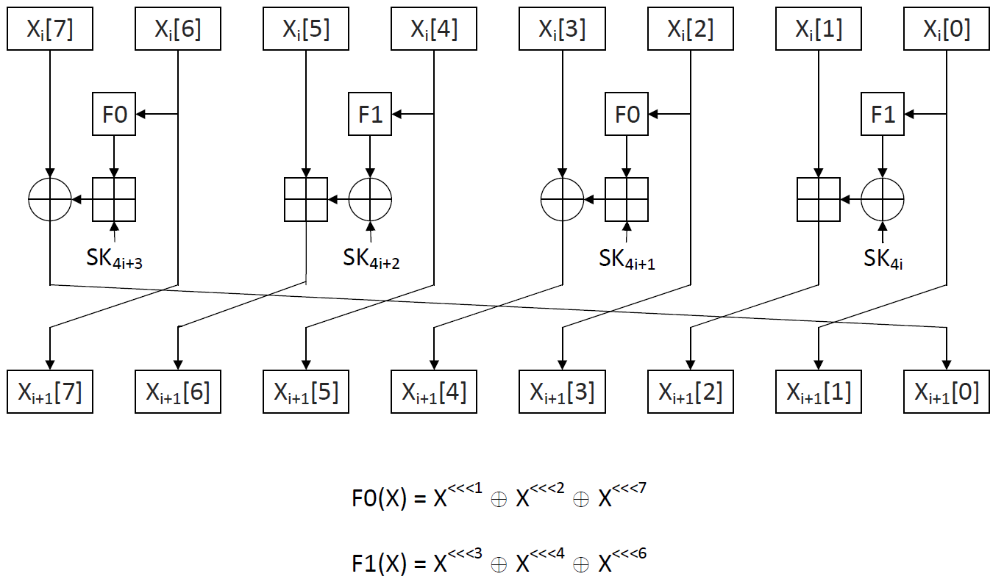
Background (HIGHT Block Cipher)
HIGHT (CHES’06)
ISO/IEC 18033-3 international block cipher
64-bit block / 8-bit word
128-bit key size
32 round
Addition/Rotation/eXclusive-or (ARX) architecture

Slide 8
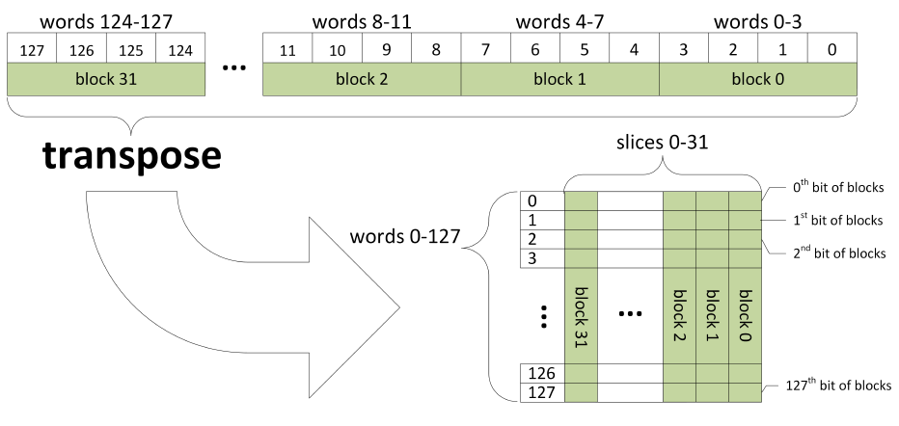
Previous Works (Fault Attack Resistance in SW: SAC’16)
Transpose of 32 blocks (128-bit wise) to 128 32-bit words

Slide 9
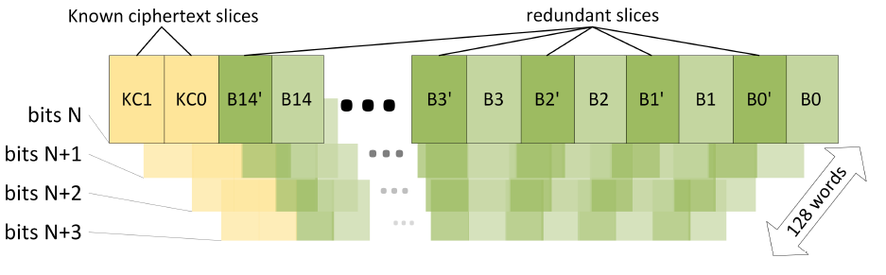
Previous Works (Fault Attack Resistance in SW: SAC’16)

Slide 10
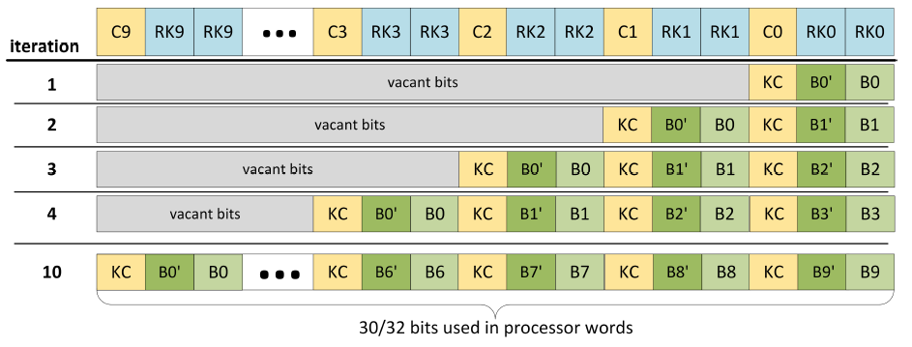
Previous Works (Fault Attack Resistance in SW: SAC’16)

Slide 11
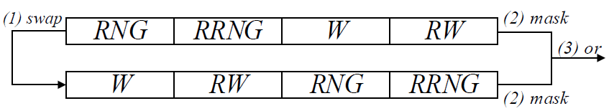
Previous Works (Random Shuffling: WISA’17)
Random shuffling
Generating random number and shuffling the word
Notation
RNG :random number generator
RRNG :redundant random number generator
W :plaintext in word
RW :redundant plaintext in word

Slide 12
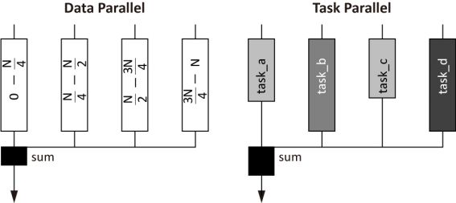
Background (Parallel Computation)
Proposed HIGHT implementation
both data and task parallelism
light random shuffling

Slide 13
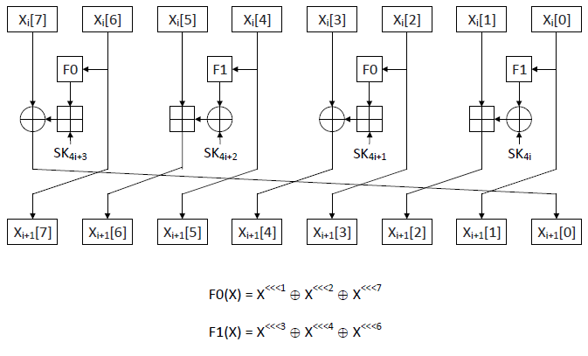
Task-parallel Implementation
Red and blue blocks can be computed in task parallel way

Slide 14
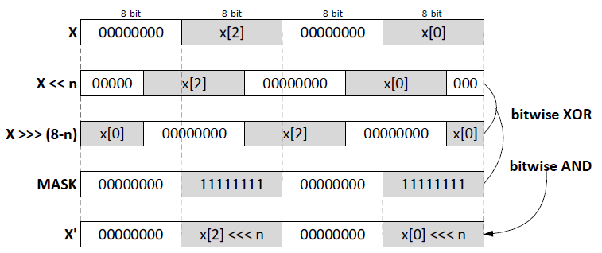
Previous works (Pseudo SIMD: TEC’18)
Cortex-M does not provide SIMD-rotation
Pseudo technique is available with padding

Slide 15
Proposed Method: Task/Data-parallel Implementation
Operation | SIMD
Rotation | Pseudo SIMD
Addition | UADD8
eXclusive-or | EOR
1
1
Masked separation
Task parallel
2
F0/F1 function in task parallel
2
T0
T1
T0
T1
3
Integration & ADD & EOR
3
Task parallel
Data parallel

Slide 16
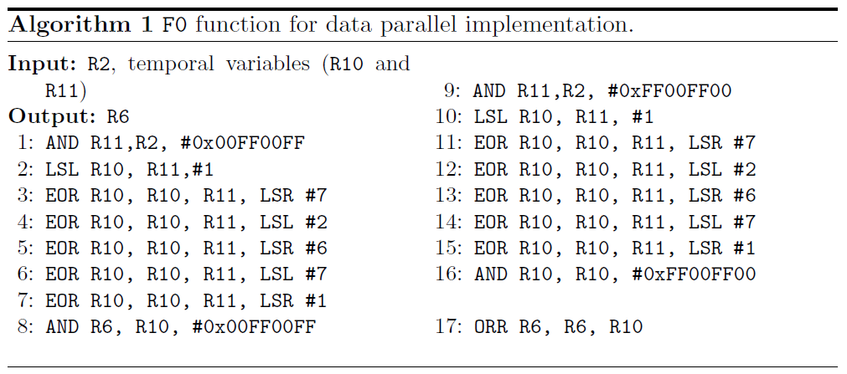
Proposed Method: Task/Data-parallel Implementation (F0 function)
Masked separation

Slide 17
Proposed Method: Task/Data-parallel Implementation (F0 function)
F0 function in task parallel
barrel shifter
barrel shifter

Slide 18
Proposed Method: Task/Data-parallel Implementation (F0 function)
Integration

Slide 19
Proposed Method: Fault Attack Resistant Implementation
Intra-redundant implementation
T0: plaintext
R0: copy of T0
Task parallel
T0
R0
T0
R0
Data parallel
Task parallel

Slide 20
Proposed Method: Fault Attack Resistant Implementation
Message shuffling
Plaintext and round key are shuffed together.
In last round, the order is recovered.
T0
R0
T0
R0
K0
K0
K1
K1
T0
R0
T0
R0
K1
K1
K0
K0

Slide 21
Proposed Method: Fault Attack Resistant Implementation
Overall process
Parameter Loading
Message Duplication
Parameter Loading
Message/Key Shuffling #1
Round Function #1
Computation order
Round Function #1
…
…
Round Function #32
Message/Key Shuffling #32
Original
Round Function #32
Last Message/Key Order Recovery
Secure version

Slide 22
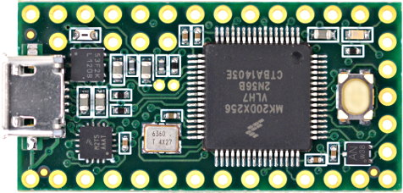
Evaluation (Taget Platform)
32-bit Cortex-M4@72MHz
Teensy 3.2 development board
256KB flash memory
64KB RAM
2KB EEPROM

Slide 23
Evaluation (Code Size)
M4 provides more optimized code size with SIMD instruction
Method | Code size (bytes) |  |  |  | RAM (bytes) |  |  | Execution time (cycles per byte)
 | EKS | ENC | DEC | SUM | EKS | ENC | DEC | EKS | ENC | DEC
HIGHT 64/128
Task (M3) [TEC’18] | 154 | 352 | 352 | 858 | 316 | 180 | 180 | 33 | 197 | 234
This work
Task (M4) | 116 | 348 | 332 | 796 | 316 | 180 | 180 | 18 | 76 | 71
T/D (M4) | 160 | 592 | 544 | 1,296 | 316 | 188 | 188 | 49 | 56 | 55
Fault (M4) | 160 | 536 | 520 | 1,216 | 316 | 188 | 188 | 49 | 143 | 143

Slide 24
Evaluation (RAM)
RAM consumption is similar
Method | Code size (bytes) |  |  |  | RAM (bytes) |  |  | Execution time (cycles per byte)
 | EKS | ENC | DEC | SUM | EKS | ENC | DEC | EKS | ENC | DEC
HIGHT 64/128
Task (M3) [TEC’18] | 154 | 352 | 352 | 858 | 316 | 180 | 180 | 33 | 197 | 234
This work
Task (M4) | 116 | 348 | 332 | 796 | 316 | 180 | 180 | 18 | 76 | 71
T/D (M4) | 160 | 592 | 544 | 1,296 | 316 | 188 | 188 | 49 | 56 | 55
Fault (M4) | 160 | 536 | 520 | 1,216 | 316 | 188 | 188 | 49 | 143 | 143

Slide 25
Evaluation (Execution Time)
Proposed Task/Data parallel implementation requires long timing for key scheduling
However, encryption and decryption show much better performance
Method | Code size (bytes) |  |  |  | RAM (bytes) |  |  | Execution time (cycles per byte)
 | EKS | ENC | DEC | SUM | EKS | ENC | DEC | EKS | ENC | DEC
HIGHT 64/128
Task (M3) [TEC’18] | 154 | 352 | 352 | 858 | 316 | 180 | 180 | 33 | 197 | 234
This work
Task (M4) | 116 | 348 | 332 | 796 | 316 | 180 | 180 | 18 | 76 | 71
T/D (M4) | 160 | 592 | 544 | 1,296 | 316 | 188 | 188 | 49 | 56 | 55
Fault (M4) | 160 | 536 | 520 | 1,216 | 316 | 188 | 188 | 49 | 143 | 143

Slide 26
Evaluation (Fault Resistant)
Fault implementation shows low performance than T/D implementation.
We provide security on fault attack only except instruction skip
Method | Code size (bytes) |  |  |  | RAM (bytes) |  |  | Execution time (cycles per byte)
 | EKS | ENC | DEC | SUM | EKS | ENC | DEC | EKS | ENC | DEC
HIGHT 64/128
Task (M3) [TEC’18] | 154 | 352 | 352 | 858 | 316 | 180 | 180 | 33 | 197 | 234
This work
Task (M4) | 116 | 348 | 332 | 796 | 316 | 180 | 180 | 18 | 76 | 71
T/D (M4) | 160 | 592 | 544 | 1,296 | 316 | 188 | 188 | 49 | 56 | 55
Fault (M4) | 160 | 536 | 520 | 1,216 | 316 | 188 | 188 | 49 | 143 | 143
RAND | RW | RB | Rb | CbP | IS
O | O | O | O | O | X

Slide 27
Conclusion
Achievement
New intra-instruction redundancy HIGHT implementation on 32-bit ARM Cortex-M4
Future Works
Applying proposed methods to other block cipher (CHAM, SPECK) or platforms (AVX)

